Slide 1
The MeteoMetrics Weather Station
A professional-grade weather dashboard by Tobi Odika
Notes:
Introduce yourself and the project purpose. Briefly mention that it's the final capstone project, combining real-time data, analytics, and machine learning.

Slide 2
Executive Summary
• 15+ functional tabs with advanced weather tools
• Real-time data, analytics, and machine learning
• 6+ chart types, modern UI, and zero critical bugs
Notes:
Highlight evolution from simple tool to full meteorological platform. Mention project status as completed with full documentation.

Slide 3
Key Features
• Real-time weather & multi-city comparison
• 5-day forecasting & historical trends
• Live radar animations & severe alerts
• Health & wellness monitoring
• AI-based activity & travel suggestions
Notes:
Briefly explain each feature category, focusing on benefits to the user.

Slide 4
Technical Architecture
• MVC pattern with modular components
• Tkinter frontend, matplotlib charts
• OpenWeatherMap API integration
• Machine learning for predictions
Notes:
Describe how the architecture supports maintainability and scalability.

Slide 5
User Interface Highlights
• Modern split-panel layout
• Professional styling & color schemes
• Interactive charts with multiple types
• Quick Actions dashboard
Notes:
Emphasize how the UI design enhances usability and engagement.

Slide 6
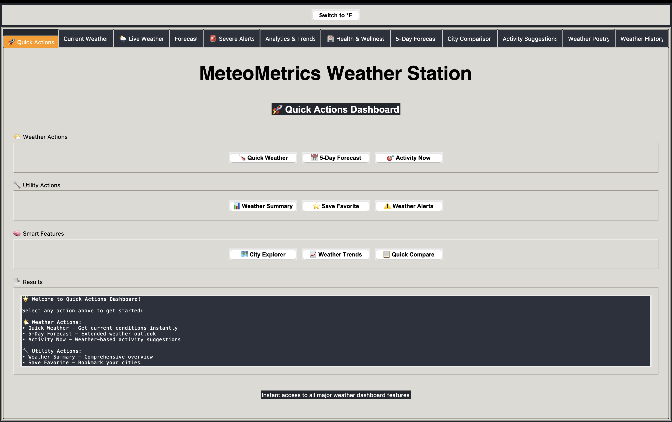
Quick Actions Dashboard
Notes:
Show how Quick Actions centralizes major features.

Slide 7
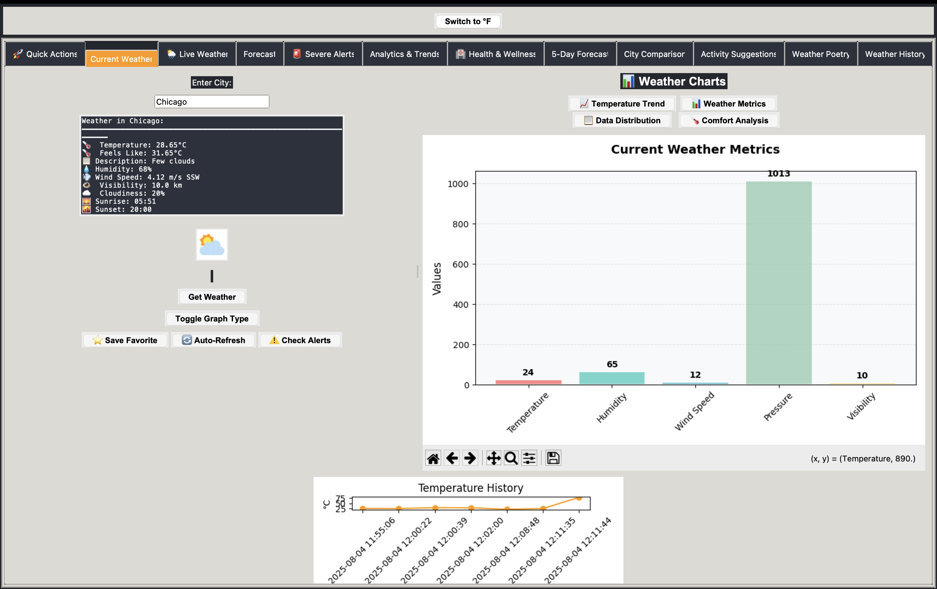
Current Weather View
Notes:
Highlight detailed metrics & real-time updates.

Slide 8
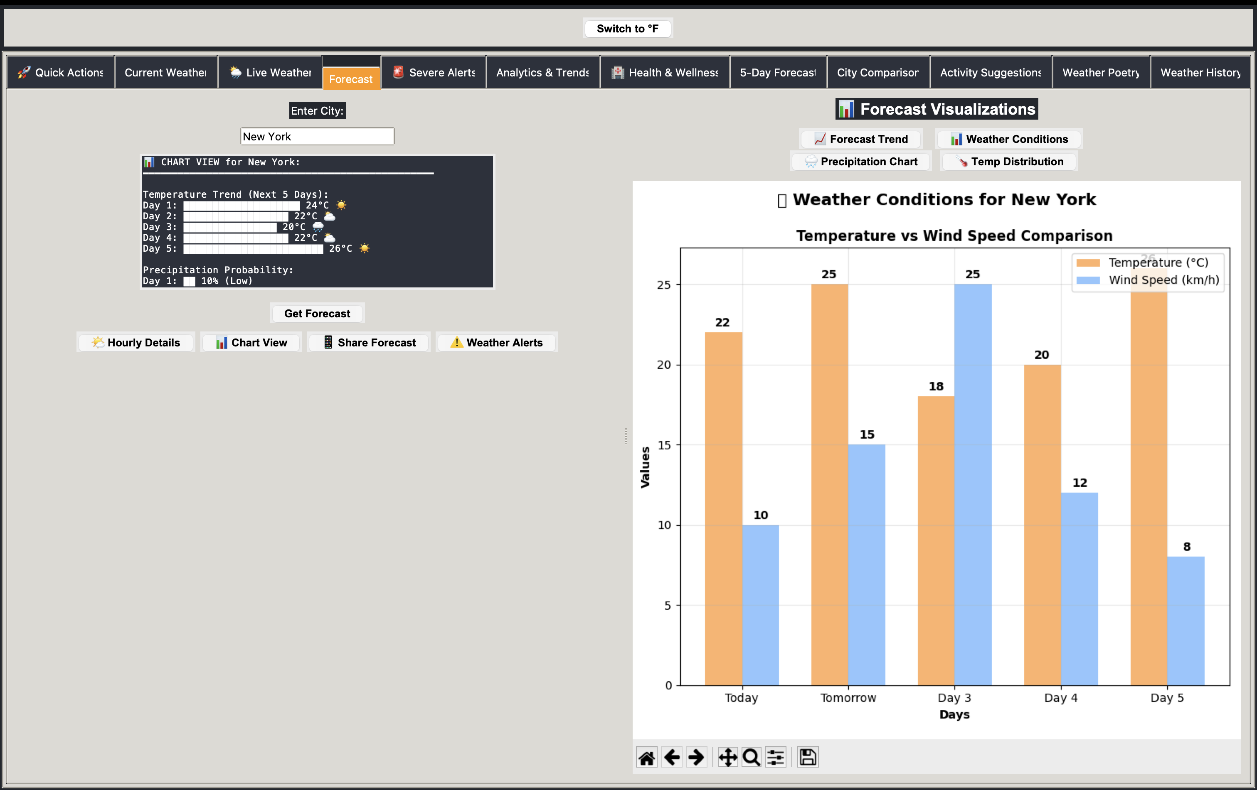
Forecast Tab
Notes:
Discuss how forecast aids planning.

Slide 9
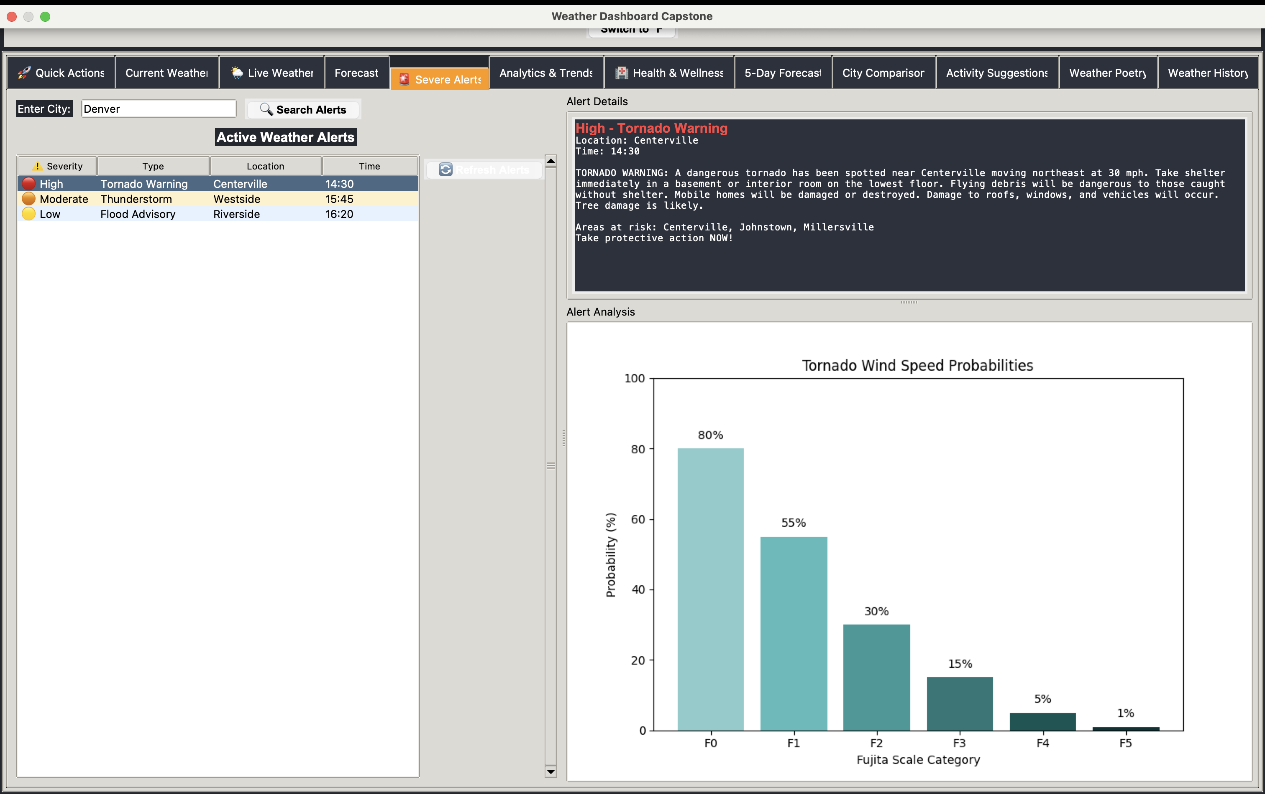
Live Weather Radar
Notes:
Demonstrate radar & live animations.

Slide 10
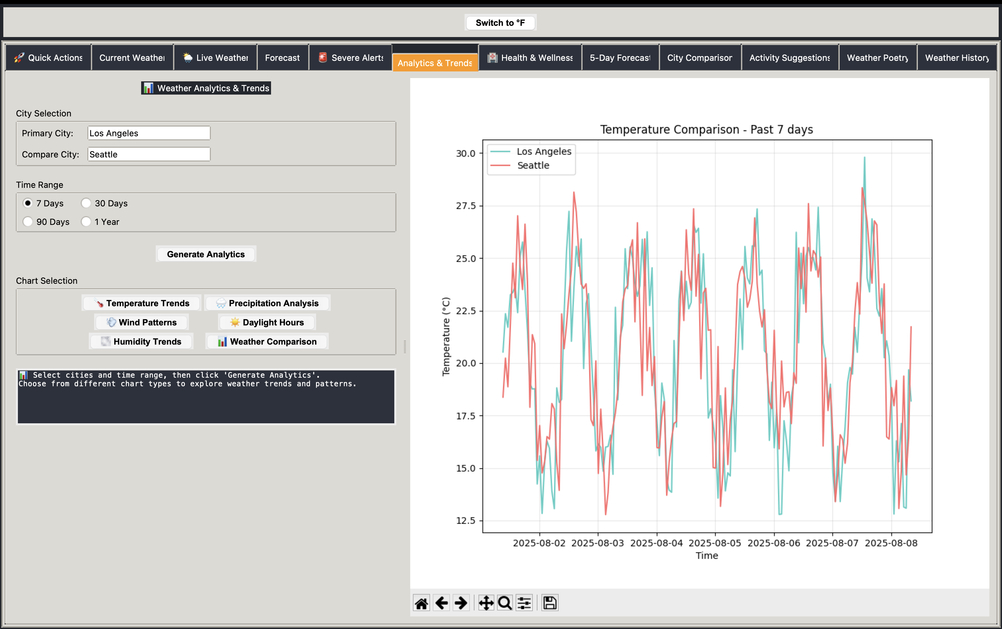
Analytics & Trends
Notes:
Show correlation & trend analysis.

Slide 11
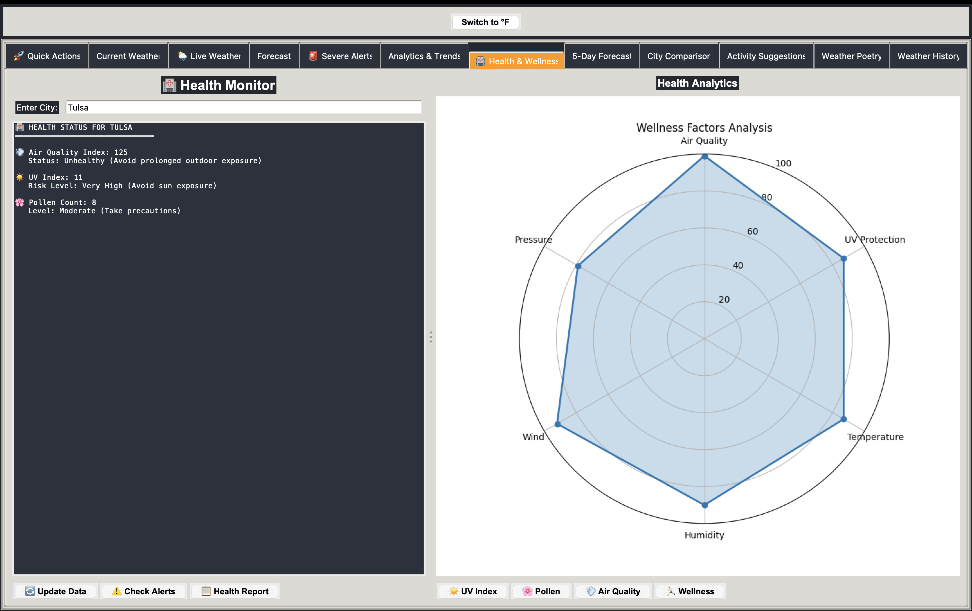
City Comparison
Notes:
Explain cross-city comparisons.

Slide 12
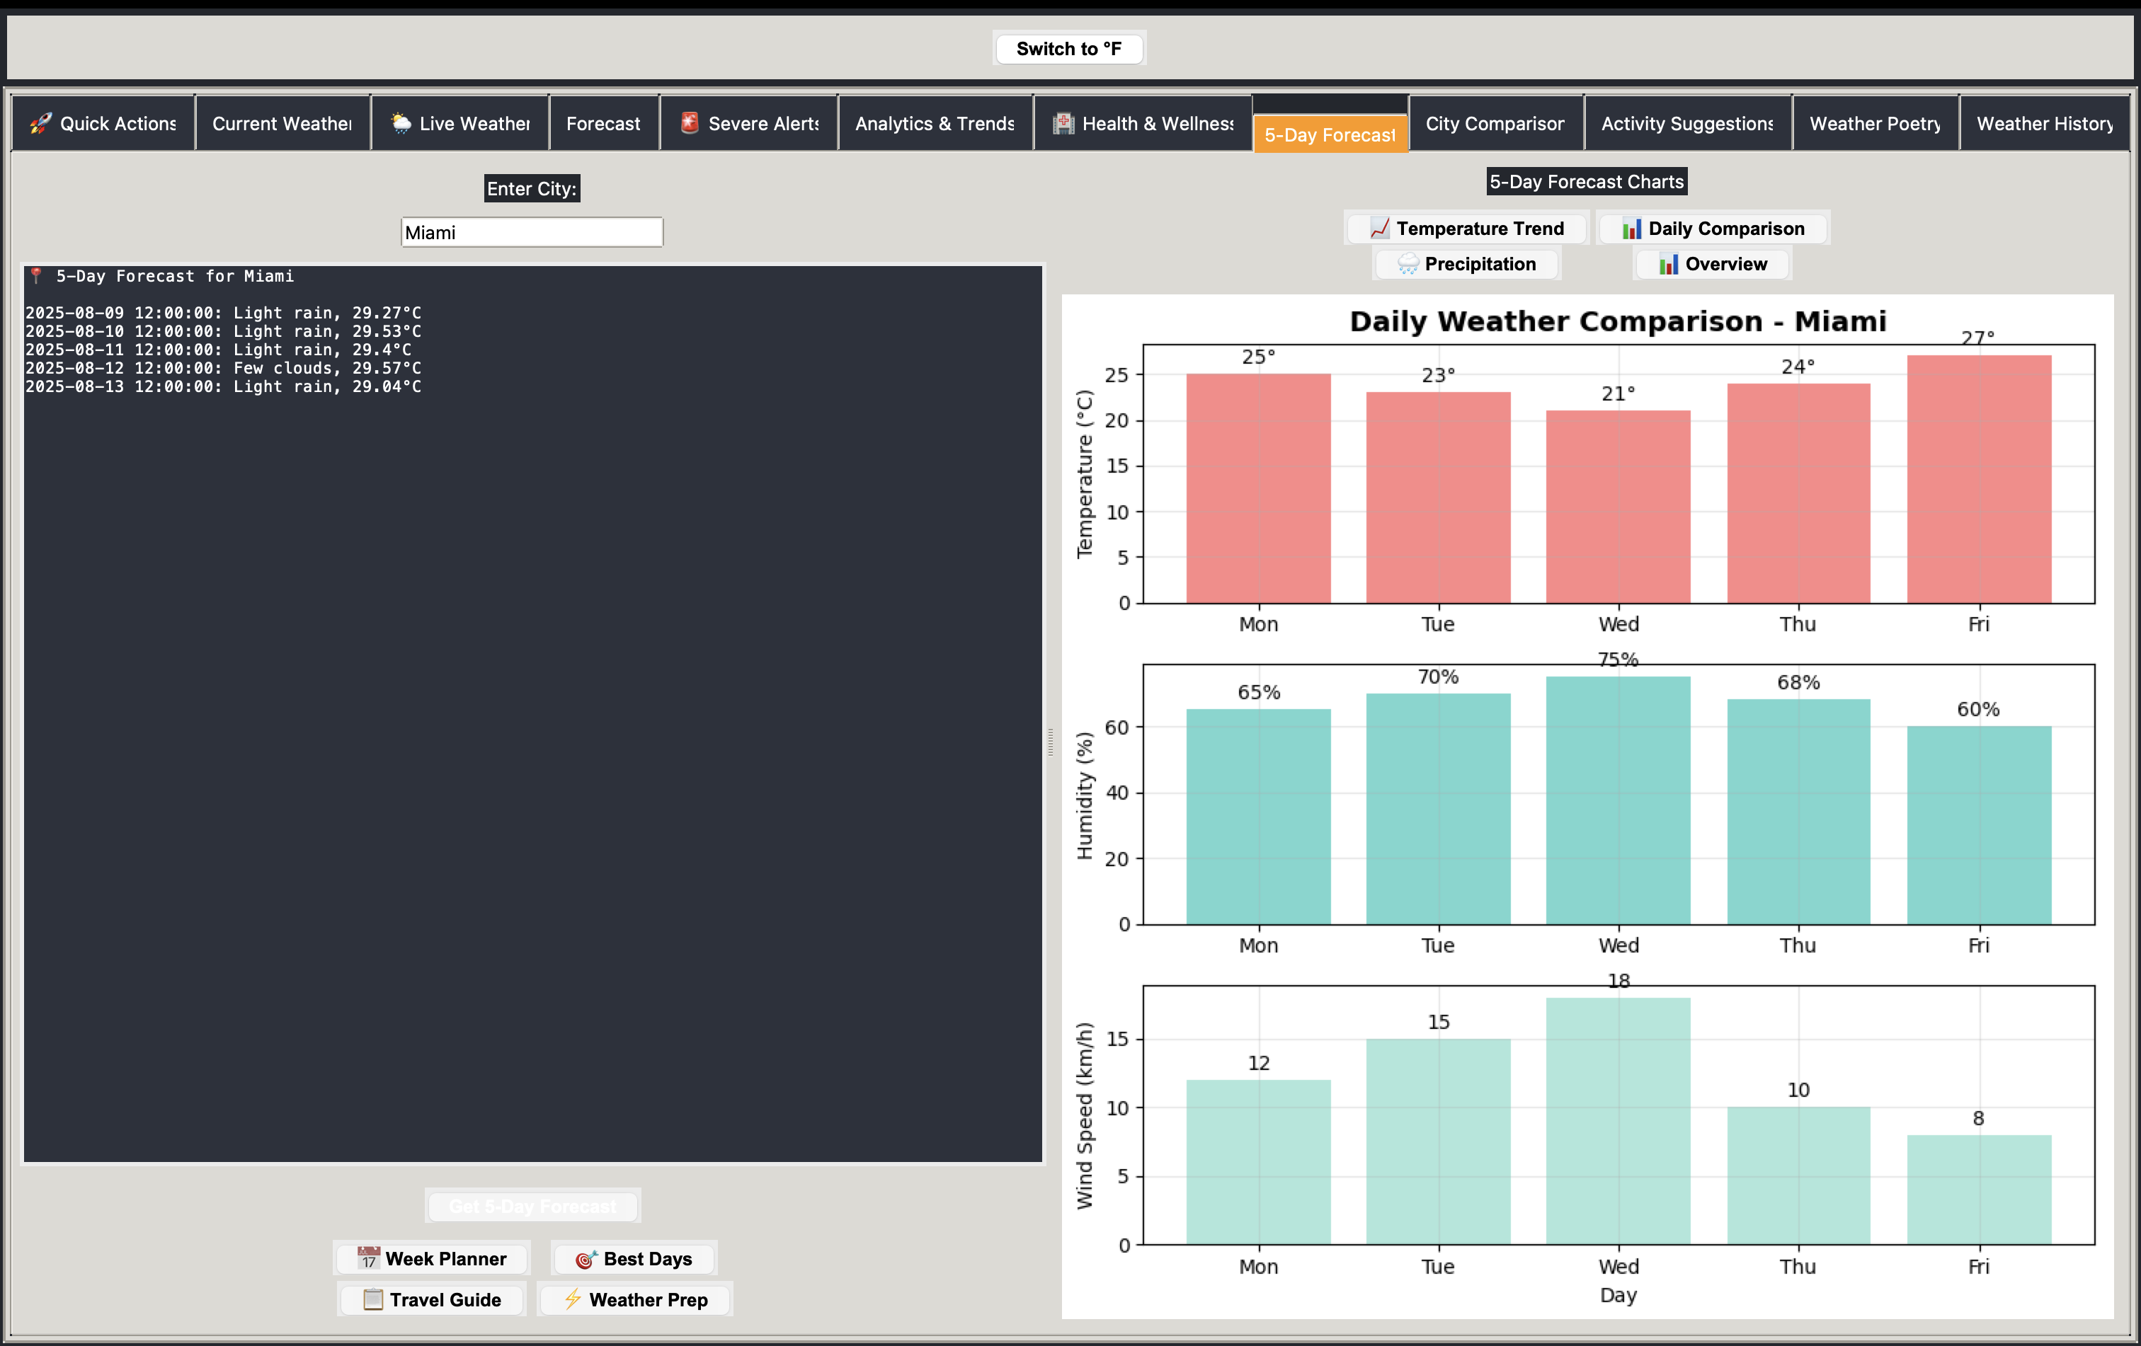
Health & Wellness
Notes:
Display health-related weather info.

Slide 13
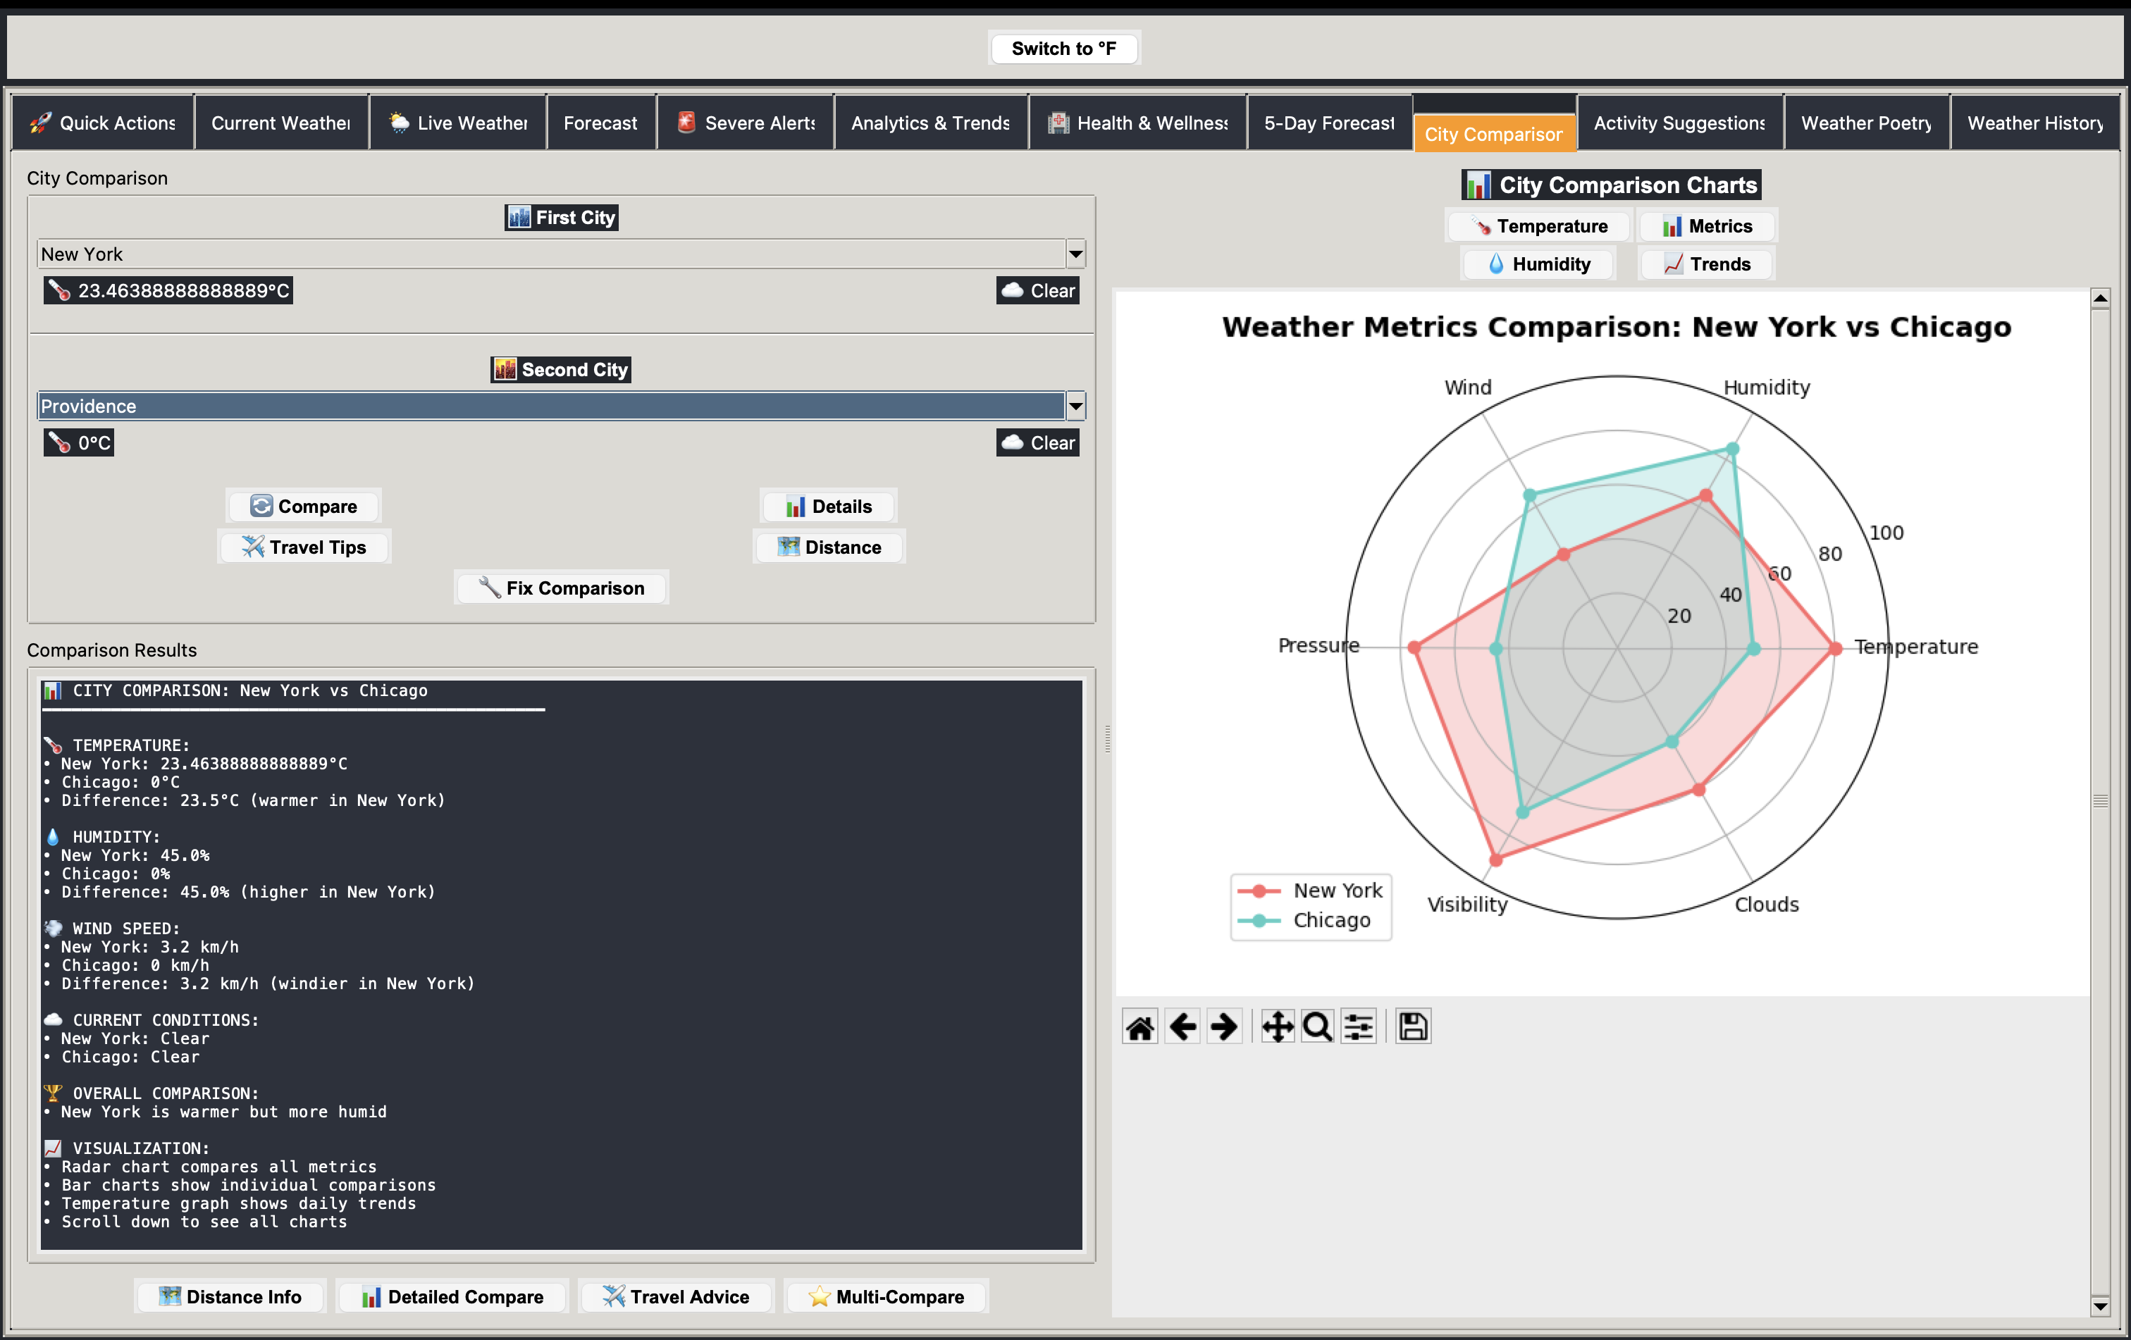
Activity Suggestions
Notes:
Point out smart suggestions feature.

Slide 14
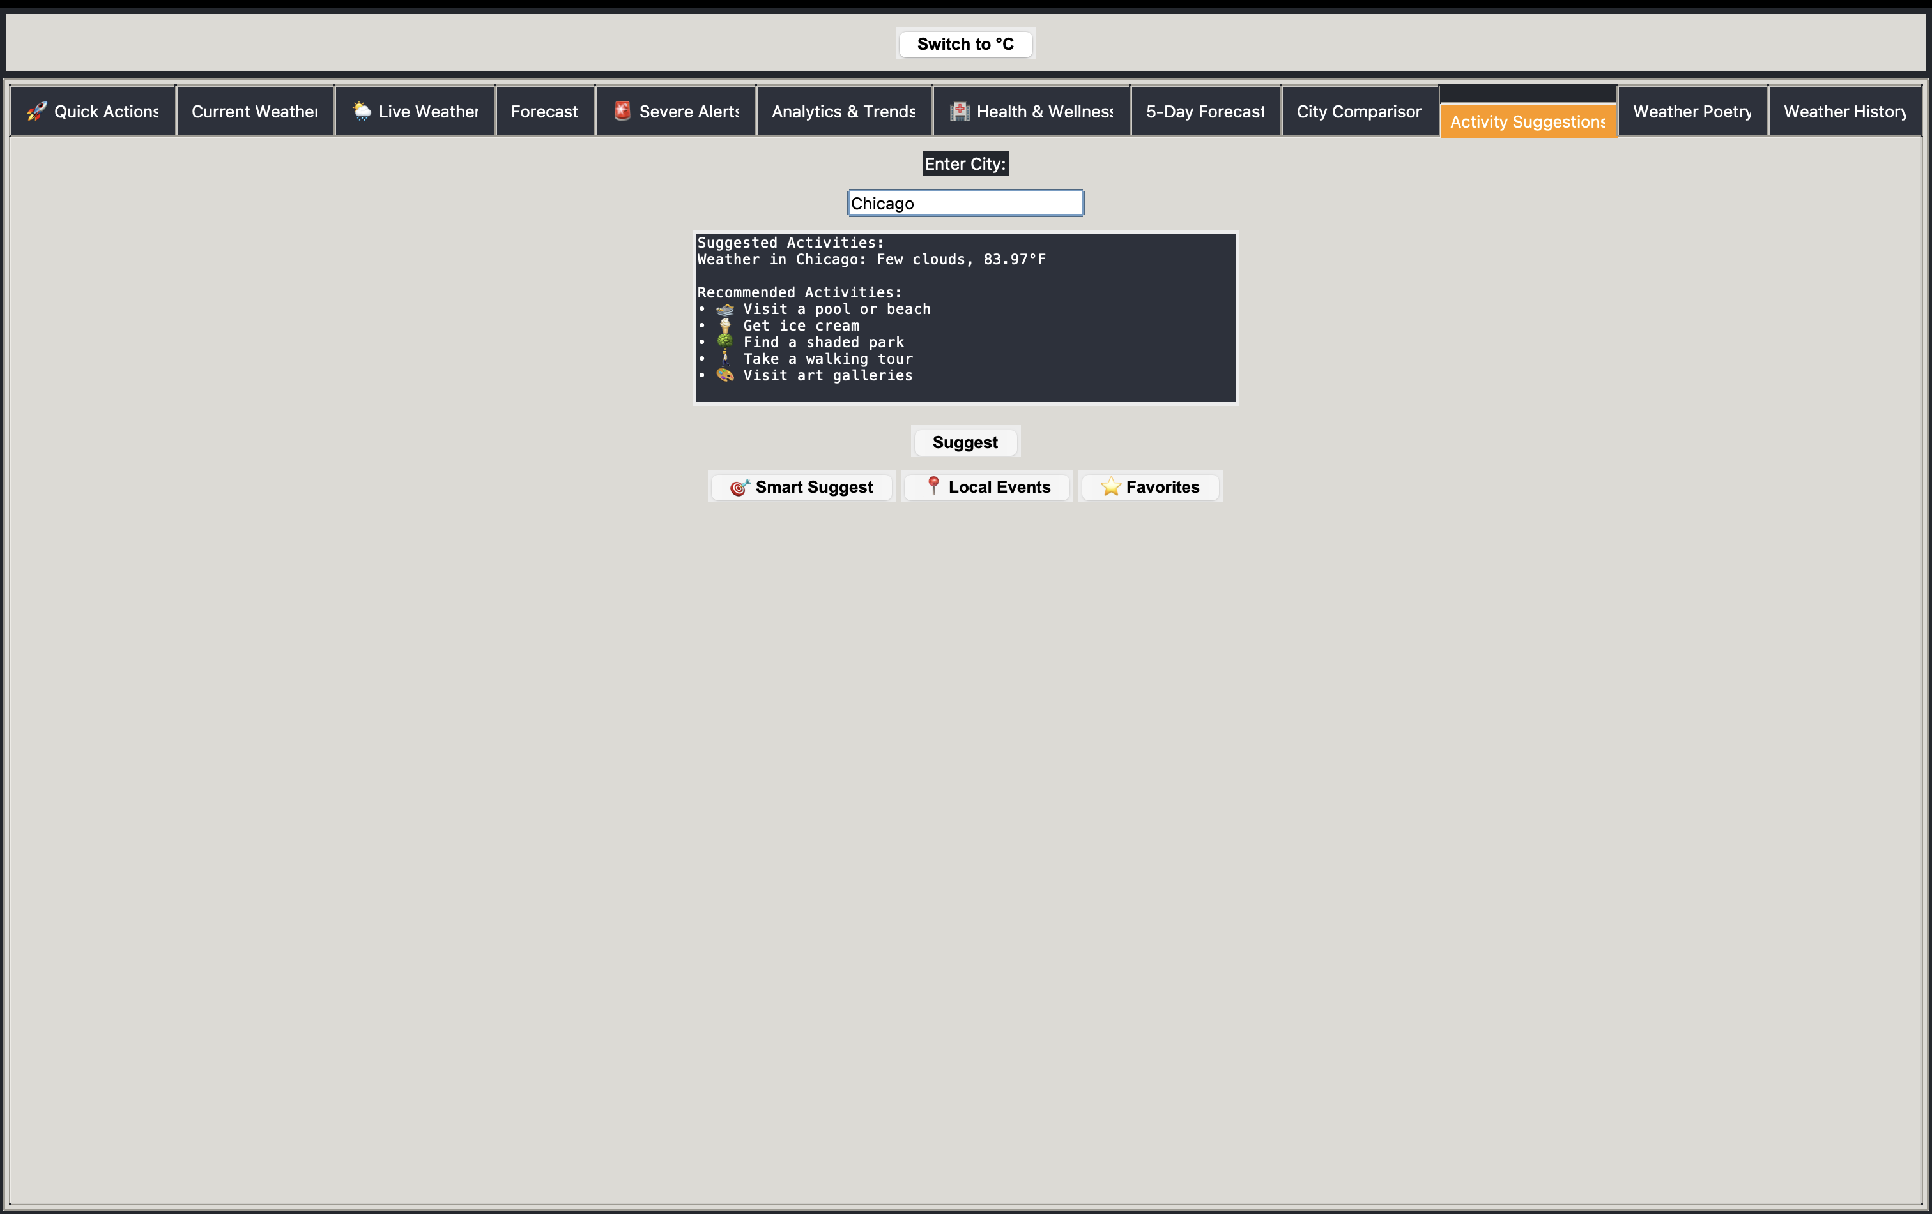
Weather Poetry
Notes:
Mention creative engagement via poetry.

Slide 15
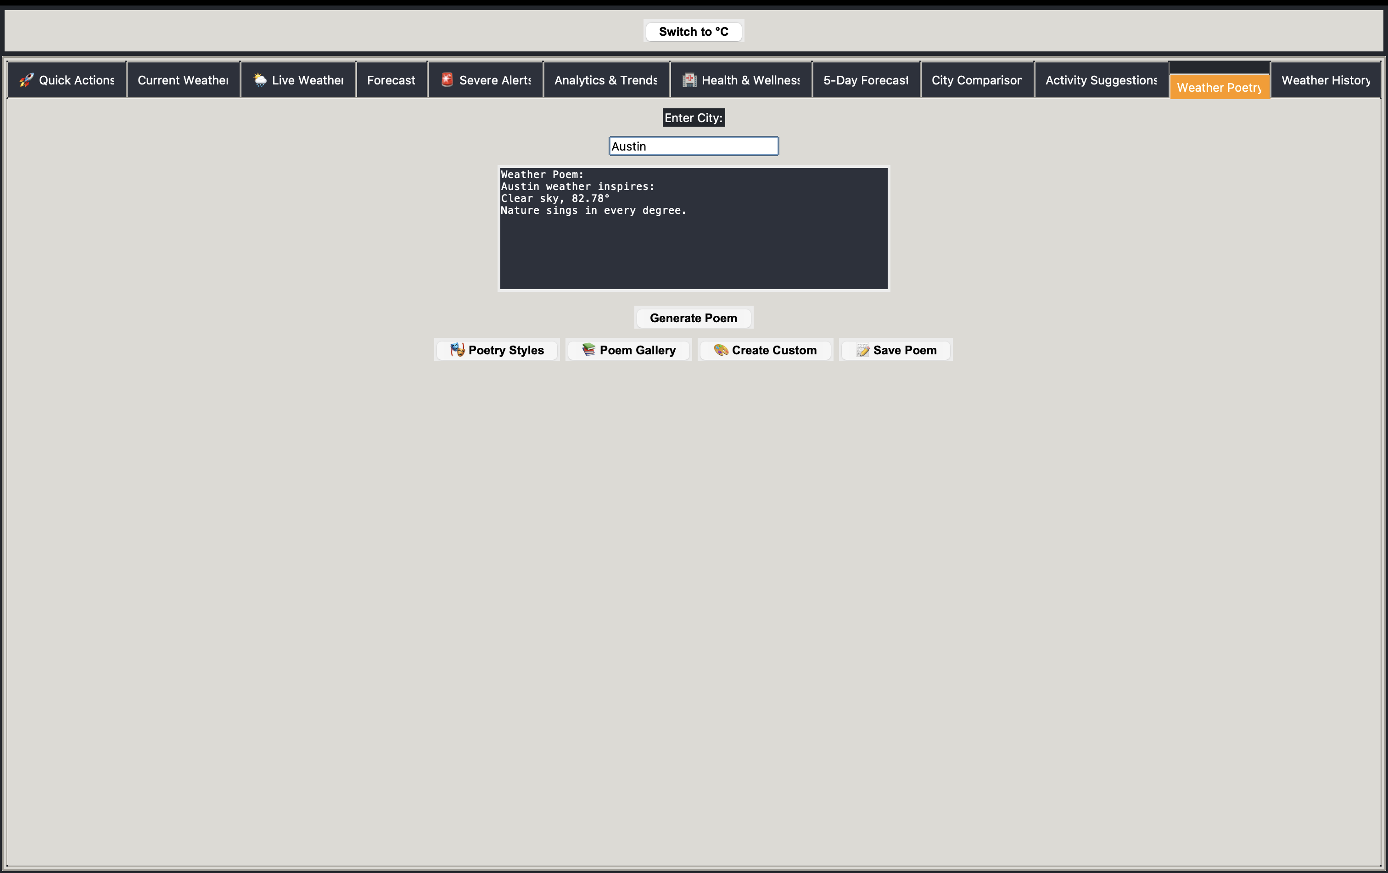
Weather History
Notes:
Show historical weather logging.

Slide 16
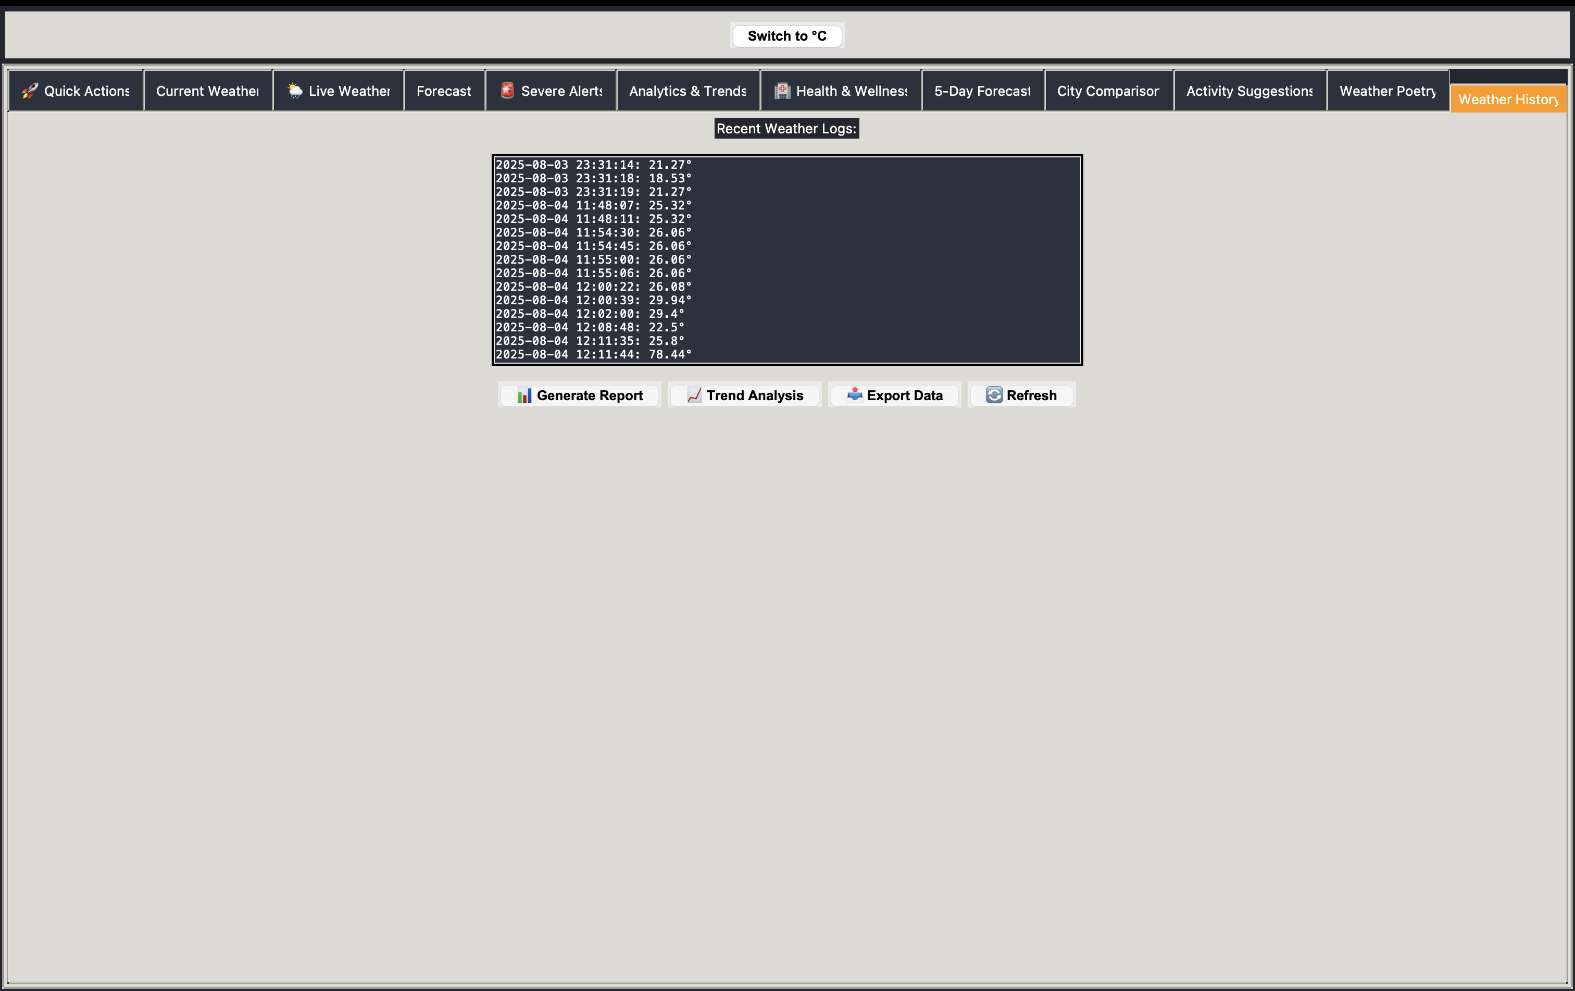
Settings
Notes:
Demonstrate customization options.

Slide 17
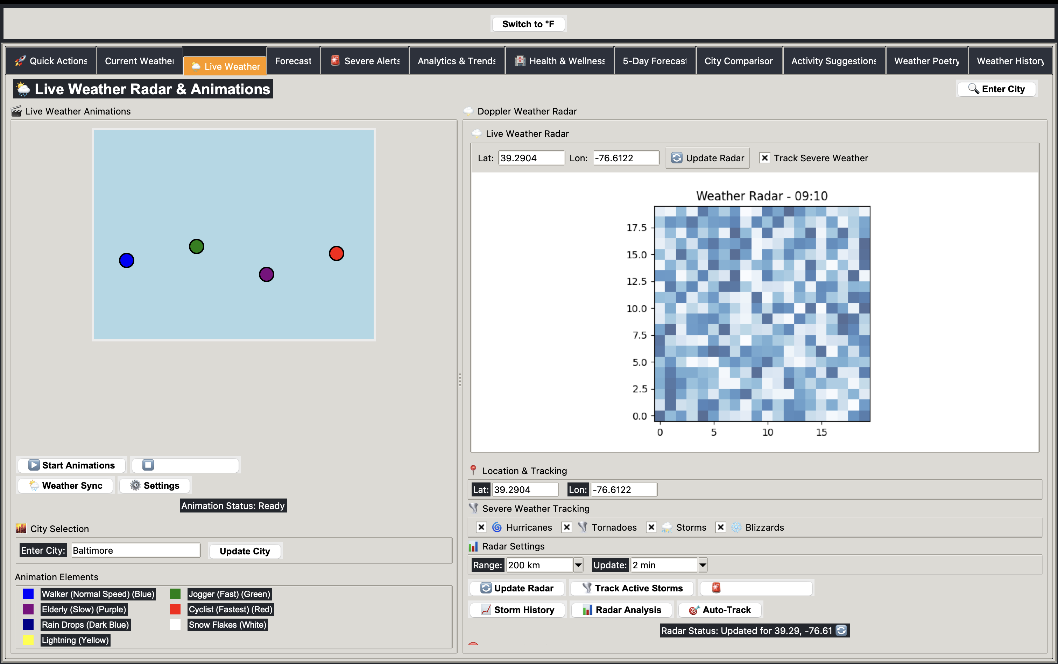
Extra Feature
Notes:
Highlight additional tools.

Slide 18
Testing & Quality Assurance
• All UI components tested
• Chart generation validated
• API integration stable
• No critical bugs
Notes:
Explain how thorough testing ensures stability.

Slide 19
Future Enhancements
• Mobile responsive design
• SQL database integration
• Enhanced ML models
• IoT weather station integration
Notes:
Conclude with forward-looking improvements.

